Slide 1


Samantha Wilson
<Date>

Slide 2

Outline
Executive Summary
Introduction
Methodology
Results
Conclusion
Appendix

Slide 3
Executive Summary
The purpose of this analysis is to provide insight on SpaceX’s capabilities to reuse its first stage rockets in order to enable SpaceY decisionmakers & stakeholders to compete in this market.
Summary of methodologies:
Data collection. SpaceX REST API; web scraping techniques with BeautifulSoup
Data Wrangle. Performed Exploratory Data Analysis (EDA) to discover patterns and to label supervised models
Exploratory Analysis. Execute SQL queries to determine data usability to automatically determine first stage landing success or failure outcomes
Visual Analysis. Annotate SpaceX launch location on an interactive map using Folium
Predictive Analysis. Build machine learning pipeline to determine if the first stage of Falcon 9 will successfully land
Summary of Results:
Exploratory Data Analysis
Observed success rates for the following orbit types: ES-L1, SSO, HEO, GEO
No launches at Vandenberg SFB for payload masses of over 10,000kg
Upward trend in successful launches from 2013 to 2020
Visual Analytics
All four observed launch sites are located within the southern portion of the United States, close to the equator and are all along the coast
Predictive Analysis
Four different built models predicted an 83% accuracy of a successful outcome
Notes:
Summary of methodologies
Summary of all results

Slide 4
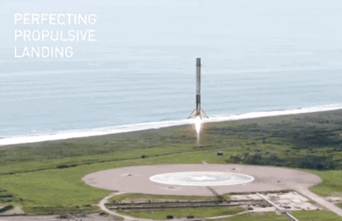
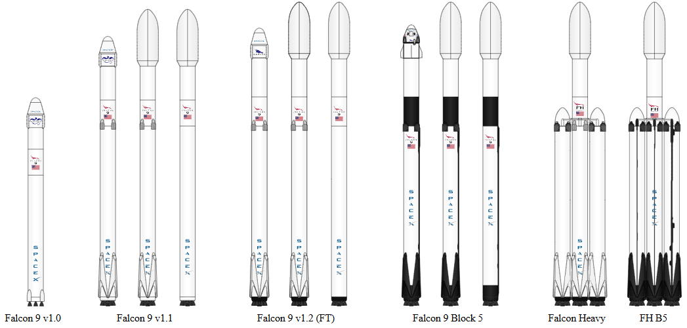
Introduction
Background:
SpaceX has dominated the commercial space business with advertised cost-effective rocket launches. The company’s Falcon 9 rocket costs 65% less than its competitor’s rockets by reusing its first stage booster. The purpose of this report is to inform SpaceY stakeholders insight on SpaceX’s successful outcome for reusing their first stage boosters.
Current Problem Set:
Will the current Falcon 9 data provide enough insight on historic landing outcomes?
Is there a correlation between launch site location and payload orbit type?
How accurate is the next predictive test launch based on historic data?
Notes:
Project background and context
Problems you want to find answers

Slide 5

Section 1

Slide 6
Methodology
Executive Summary
Data collection methodology:
SpaceX API
Request & parse data using GET request
Filter data frame to only analyze Falcon 9 launches
Web scrape Falcon 9 launch records using BeautifulSoup
Perform data wrangling
Launch sites, orbit types, and landing outcome were extracted from the data set, using Pandas & NumPy libraries, to determine training labels
Perform exploratory data analysis (EDA) using visualization and SQL
Perform interactive visual analytics using Folium and Plotly Dash
Perform predictive analysis using classification models
Performed the train_test_split function to split the data into 80% training data & 20% test data
Performed Logistic Regression, Support Vector Machine Regression, Decision Tree Classifier, & K-Nearest Neighbor Classifier to determine most accurate successful outcome prediction
Notes:
Data collection methodology:
Describe how data was collected
Perform data wrangling
Describe how data was processed
Perform exploratory data analysis (EDA) using visualization and SQL
Perform interactive visual analytics using Folium and Plotly Dash
Perform predictive analysis using classification models
How to build, tune, evaluate classification models

Slide 7
Data Collection
After downloading the libraries, a series of helper functions were established in order to use the API
Using the GET request, the following functions were defined:
Rocket – retrieve booster name
Launchpad – retrieve launch site names with coordinates
Payload – retrieve payload mass and associated orbit type
Cores – retrieve landing outcomes, types of landing, & number of flights
After GET request was used to request data from SpaceX API, data was parsed using JSON functions
Finally, data was turned into a Pandas data frame including the abovementioned defined functions
Falcon 9 launches data was collected for this analysis

Slide 8
Data Collection – SpaceX API
SpaceX API
Request data from URL
Check response content
GET Request
Request JSON results using static response object
200 status responses requested
Pandas Data Frame
Convert JSON response into Pandas data frame using .json_normalize() function
SpaceX API used to retrieve information for four specific columns
Falcon 9 Launches
Data frame is filtered to only use Falcon 9 launch records
GitHub: https://github.com/swilson1108/Space_Y_Repo/blob/main/jupyter-labs-spacex-data-collection-api.ipynb
Notes:
Present your data collection with SpaceX REST calls using key phrases and flowcharts
Add the GitHub URL of the completed SpaceX API calls notebook (must include completed code cell and outcome cell), as an external reference and peer-review purpose

Slide 9
Data Collection - Scraping
Falcon 9 Launch
Request Falcon 9 launch records from Wiki page URL
HTTP GET method
HTML Table Header
Collect all relevant column names using BeautifulSoup
Parse HTML Tables
Create empty dictionary with keys
Convert to data frame
Created BeautifulSoup object from HTML response
Verify object creation
Verify extracted column names
Parse all launch tables
GitHub: https://github.com/swilson1108/Space_Y_Repo/blob/main/jupyter-labs-webscraping.ipynb
Notes:
Present your web scraping process using key phrases and flowcharts
Add the GitHub URL of the completed web scraping notebook, as an external reference and peer-review purpose

Slide 10
Data Wrangling
From the collected dataset, percentage of missing values were identified
Using the value_counts() method, the number of launches from four sites, orbit types, & landing outcomes were calculated
Based on the landing outcomes, types were classified and assigned a class
Class 1 – successful
Class 0 - failure
GitHub: https://github.com/swilson1108/Space_Y_Repo/blob/main/labs-jupyter-spacex-Data%20wrangling.ipynb

Slide 11
EDA with Data Visualization
For the analyses, the following graphs were performed:
Scatter plot. Various columns such as pay load mass, launch locations, and flight numbers were compared to visualize patterns and correlations
Bar plot. Success rates were compared against orbit types to determine correlation
Line plot. Launch years were compared against success rates to determine trends
GitHub: https://github.com/swilson1108/Space_Y_Repo/blob/main/edadataviz.ipynb
Notes:
Summarize what charts were plotted and why you used those charts
Add the GitHub URL of your completed EDA with data visualization notebook, as an external reference and peer-review purpose

Slide 12
EDA with SQL
Query for string entries in the SPACEXTBL table. Use LIKE function with key word string and % symbol to query like terms
Display average column entry in SPACEXTBL table. Select column with integer/float entries and define average input
Identify first successful landing outcome. Use MIN() function and define as earliest date from date column and filter for successful landing outcomes
Identify F9 boosters of a given payload mass range with successful drone ship landing. Filter range using greater or equal & less than or equal functions
List total number of successful & failure landing outcomes. Count number of successful/failed outcomes and group by outcome column
Identify all F9 boosters with maximum payload mass. Filter payload mass with maximum value
List records of failure landing outcomes in drone ship. Use substr(Date, 6, 2) & substr(Date, 0, 5) functions to convert date value and list extracted month based on launch site
Rank number of landing outcomes between a given date range. Use rank function and filter from given date range.
GitHub: https://github.com/swilson1108/Space_Y_Repo/blob/main/jupyter-labs-eda-sql-coursera_sqllite%20(1).ipynb
Notes:
Using bullet point format, summarize the SQL queries you performed
Add the GitHub URL of your completed EDA with SQL notebook, as an external reference and peer-review purpose

Slide 13
Build an Interactive Map with Folium
Using the folium.Circle & folium.Marker functions, all four Falcon 9 launch sites were added onto the OpenStreetMap map
Cape Canaveral Launch Complex – 40 (CCAFS LC-40): 28.562302, -80.577356
Cape Canaveral Space Launch Complex – 40 (CCAFS SLC-40): 28.563197, -80.576820
Kennedy Space Center Launch Complex – 39A (KSC LC-39A): 28.573255, -80.646895
Vandenberg Space Force Base Space Launch Complex – 4E (VAFB SLC-4E): 34.632834, -120.610745
Using the MarkerCluster function, successful/failed launch records were added onto the OpenstreetMap map
CCAFS LC-40: 7 successful; 19 failure
CCAFS SLC-40: 3 successful; 4 failure
KSC LC-39A: 10 successful; 3 failure
VAFB SLC-4E: 6 successful; 4 failure
Using the MousePosition function, coordinates are displayed where a point hovers over the map
Using the PolyLine function, a poly line is added onto the map based on two given coordinates
GitHub:
Notebook - https://github.com/swilson1108/Space_Y_Repo/blob/main/lab_jupyter_launch_site_location.ipynb
**Folium screenshots are stored within Space_Y_Repo main branch**
Notes:
Summarize what map objects such as markers, circles, lines, etc. you created and added to a folium map
Explain why you added those objects
Add the GitHub URL of your completed interactive map with Folium map, as an external reference and peer-review purpose

Slide 14
Build a Dashboard with Plotly Dash
As a data visualization tool, all four launch sites were displayed in pie charts and scatter charts
A dropdown menu is added to select either all launch sites or individual sites
Each pie chart is interactable
All Sites – separated by launch sites which provides more info is provided when hovering over each sites
Individual site – separated by class (success rate) and visually displays success rates by each site
Scatter plot chart has a range slider to filter payload mass ranges
adjusting the range slider provides data visualization of payload masses in relation to success rates
GitHub: https://github.com/swilson1108/Space_Y_Repo/blob/main/SpaceX_Dashboard_Code
**computer will not allow .py download; code is on GitHub instead**
Notes:
Summarize what plots/graphs and interactions you have added to a dashboard
Explain why you added those plots and interactions
Add the GitHub URL of your completed Plotly Dash lab, as an external reference and peer-review purpose

Slide 15
Predictive Analysis (Classification)
From the Falcon 9 dataset, NumPy array was created for Class column & assigned to Y variable; to_numpy() method was used to create array
data was standardized then reassigned to X variable; StandardScaler() & fit_transform()
data set was split into 80% train data and 20% test data
this method is used to train and test model for predictive analysis
18 test samples
Four regression models were analyzed to determine best fit for predictive analysis
Logistic Regression
Support Vector Classifier
Decision Tree Classifier
K-Nearest Neighbor Classifier
Accuracy of each model was determined by using .score() function
Confusion matrix was applied to each model in order to identify and false positives
Assign X & Y Variable
NumPy array to add class column and assign as Y variable
Standardized data in X and reassigned X variable using transform()
Split Data
Split data into train & test dataset
80% train data, 20% test data (18 test samples)
Logistic Regression
LogisticRegression() function used on train data
training data accuracy determined using best_params_, & best_score_, functions
score() used to determine test data accuracy
Support Vector Machine
confusion matrix applied to test data set to determine false positives
SVC() function used on train data
training data accuracy determined using best_params_, & best_score_, functions
score() used to determine test data accuracy
confusion matrix applied to test data set to determine false positives
DecisionTreeClassifier() function used on train data
Decision Tree
training data accuracy determined using best_params_, & best_score_, functions
score() used to determine test data accuracy
confusion matrix applied to test data set to determine false positives
K-Nearest Neighbor
KNeighborsClassifier() function used on train data
training data accuracy determined using best_params_, & best_score_, functions
score() used to determine test data accuracy
confusion matrix applied to test data set to determine false positives
Notes:
Summarize how you built, evaluated, improved, and found the best performing classification model
You need present your model development process using key phrases and flowchart
Add the GitHub URL of your completed predictive analysis lab, as an external reference and peer-review purpose

Slide 16
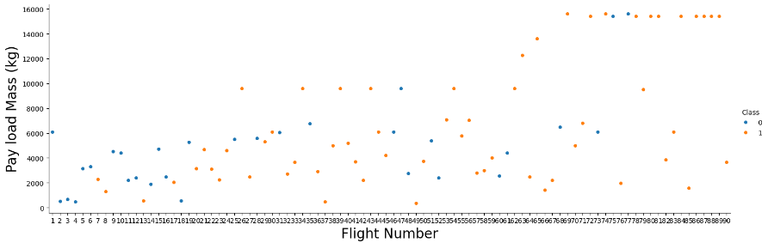
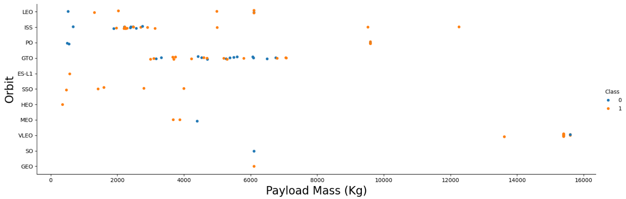
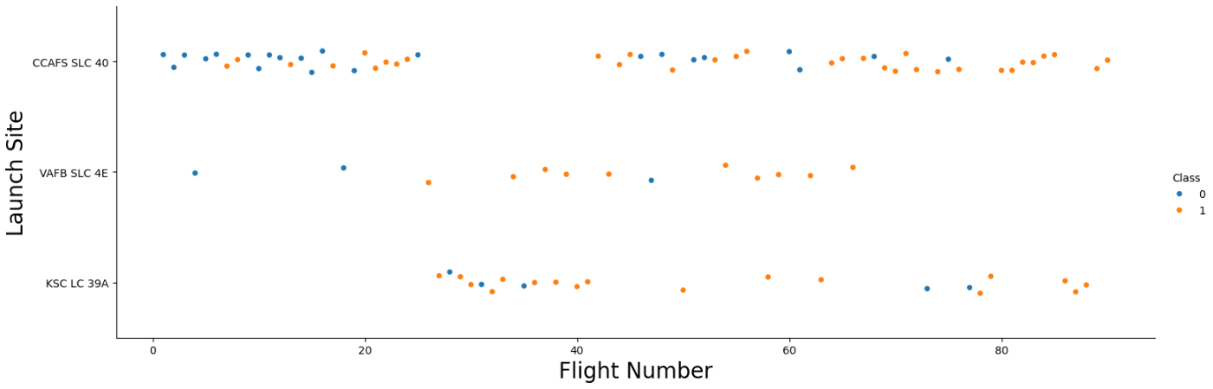
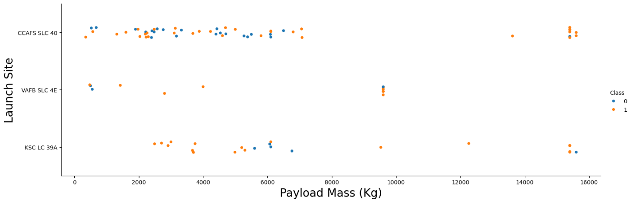
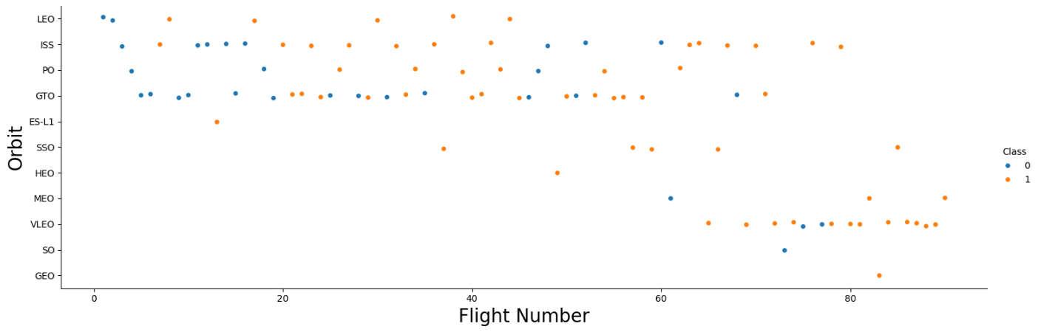
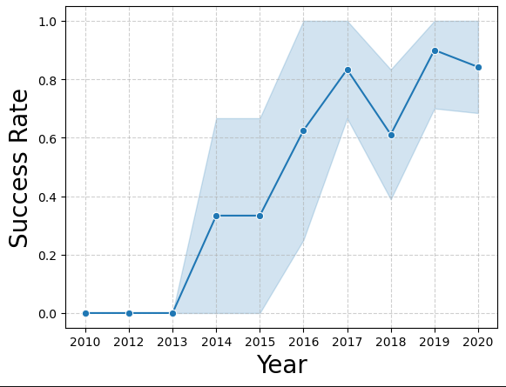
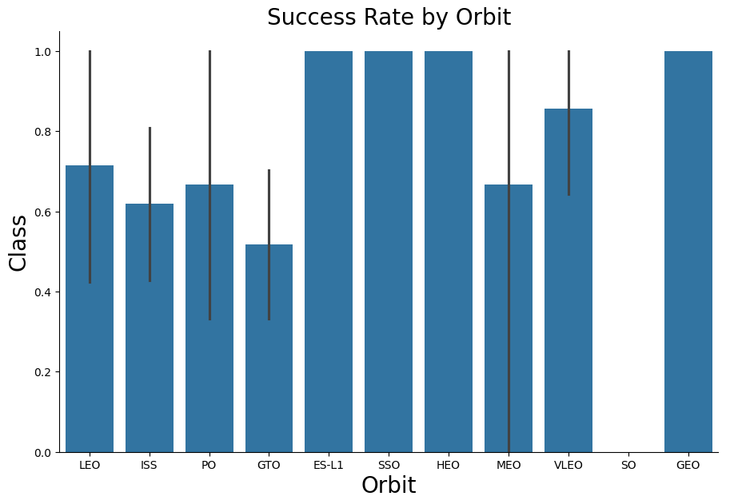
Results – Exploratory Data Analysis
Notes:
Exploratory data analysis results
Interactive analytics demo in screenshots
Predictive analysis results

Slide 17
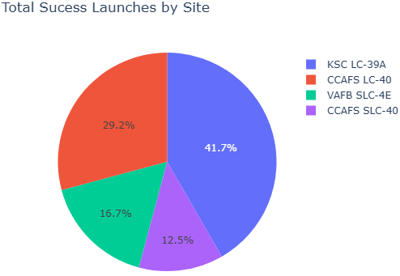
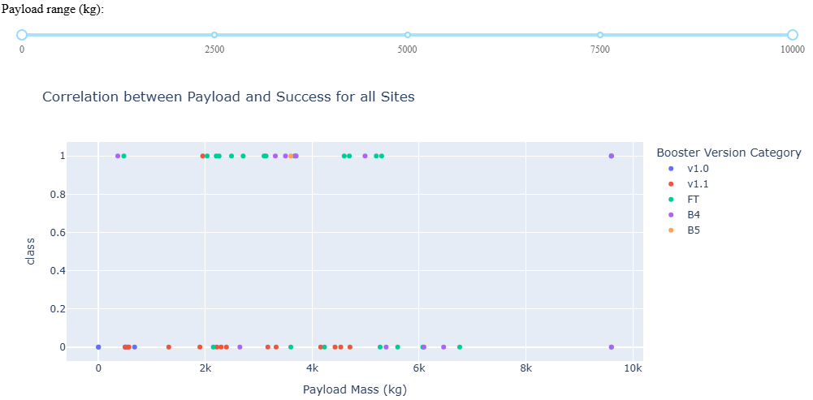
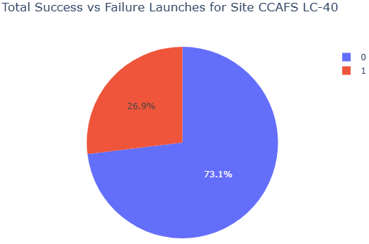
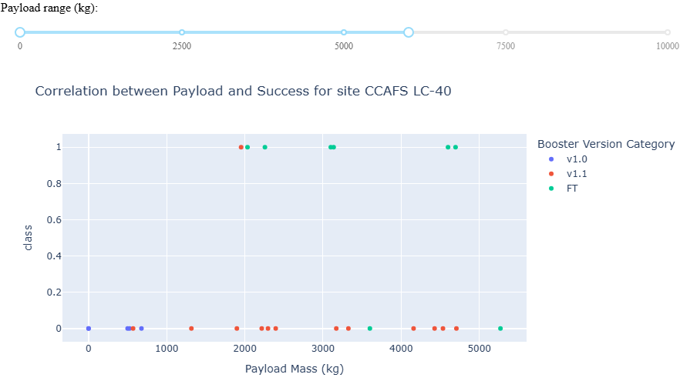
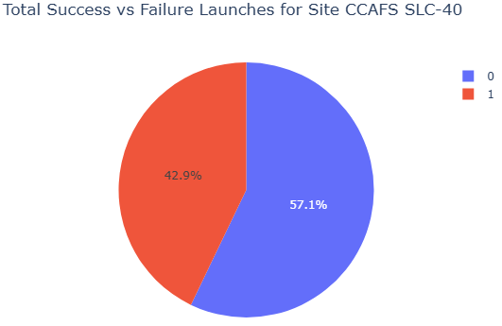
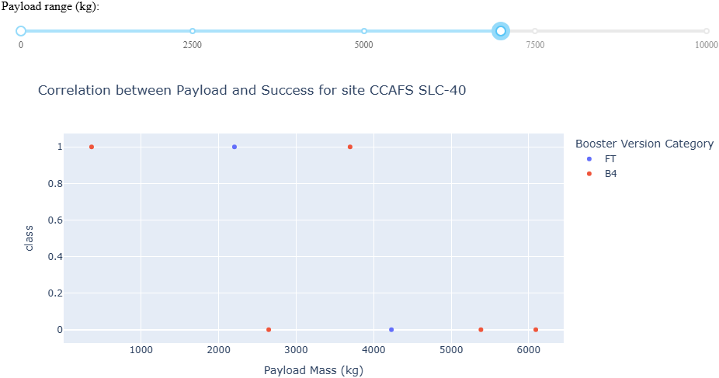
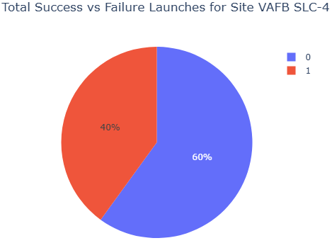
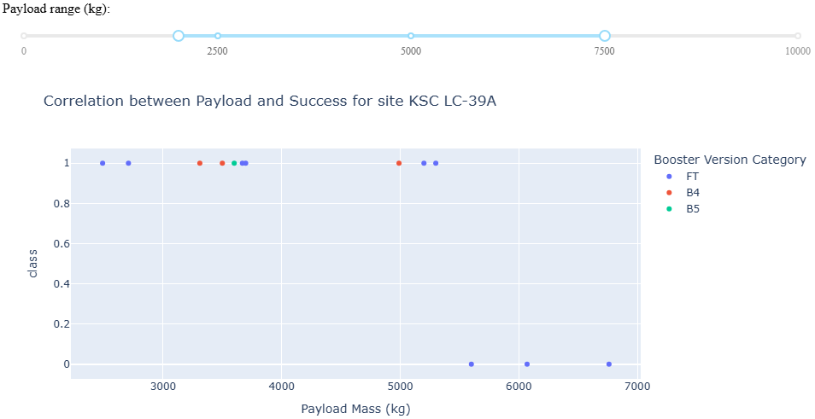
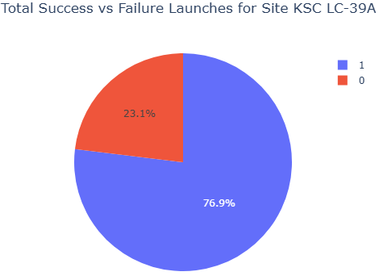
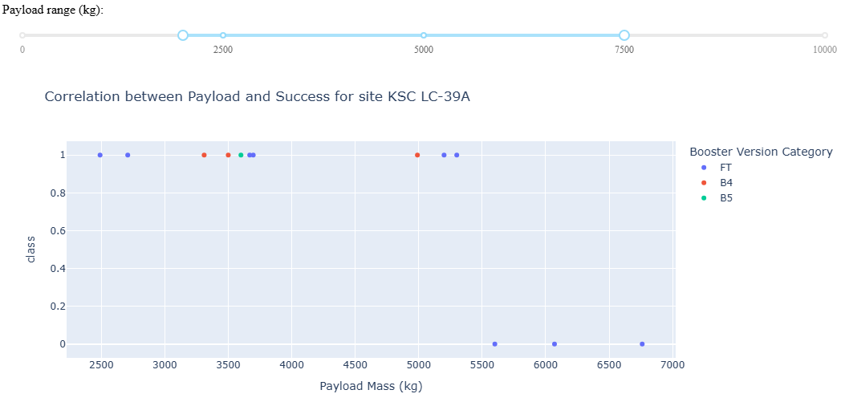
Results – Plotly Dashboard
Notes:
Exploratory data analysis results
Interactive analytics demo in screenshots
Predictive analysis results

Slide 18

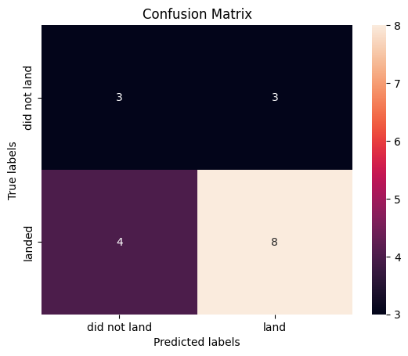
Results – Predictive Analysis
Logistic Regression
Support Vector Machine
Decision Tree Classifier
K-Nearest Neighbors
Tuned hpyerparameters : (best parameters)
{'C': 0.01, 'penalty': 'l2', 'solver': 'lbfgs’}
Validation Data Accuracy : 0.8464285714285713
Test Data Accuracy:
0.8333333333333334
Tuned hpyerparameters : (best parameters) {'C': 1.0, 'gamma': 0.03162277660168379, 'kernel': 'sigmoid’}
Validation Data Accuracy : 0.8482142857142856
Test Data Accuracy:
0.8333333333333334
Tuned hpyerparameters : (best parameters) {'criterion': 'entropy', 'max_depth': 4, 'max_features': 'sqrt', 'min_samples_leaf': 1, 'min_samples_split': 2, 'splitter': 'best'}
Validation Data Accuracy : 0.8892857142857145
Test Data Accuracy:
0.6111111111111112
Tuned hpyerparameters : (best parameters) {'algorithm': 'auto', 'n_neighbors': 10, 'p': 1}
Validation Data Accuracy : 0.8482142857142858
Test Data Accuracy:
0.8333333333333334
Notes:
Exploratory data analysis results
Interactive analytics demo in screenshots
Predictive analysis results

Slide 19

Section 2

Slide 20
Flight Number vs. Launch Site
The depicted graph shows earlier & mid to latter flight launches and were launched at the CCAFS SLC-40 site. Flight launches from VAFB SLC-4E were sporadically launched. KSC LC-39A site were used for flight launches past 20.
The CCAFS SLC-40 launch site had more successful launch outcomes during the latter half of the flights while VAFB SLC-4E & KSC LC-39A had most successful launch outcome than failed outcome.
These observed successful rates at different launch sites are likely due to changes in launch configurations at the later flights. Further information is required to confirm data patterns.
Notes:
Show a scatter plot of Flight Number vs. Launch Site
Show the screenshot of the scatter plot with explanations

Slide 21
Payload vs. Launch Site
Observed success rate by payload mass & launch sites shows that VAFB SLC-4E did not conduct flight launches with payload masses over 9,000kg while KSC LC-39A did not conduct flight launches with payload masses less than 2,500kg. Most of the flight launches at CCAFS SLC-40 were with payload masses up to 7,500kg.
These observed trends provide suggests that launch site locations are dependent on payload mass.
Notes:
Show a scatter plot of Payload vs. Launch Site
Show the screenshot of the scatter plot with explanations

Slide 22
Success Rate vs. Orbit Type
Recorded orbit types of Falcon 9 launches show 100% successful launch outcomes for ES-L1, SSO, HEO, & GEO.
Notes:
Show a bar chart for the success rate of each orbit type
Show the screenshot of the scatter plot with explanations

Slide 23
Flight Number vs. Orbit Type
The depicted graph of flight numbers and orbit types based on success rates show no launches in the HEO, MEO, VLEO, SO & GEO for flight numbers below 60. Most flights in VLEO were successful and launched after flight 60. The first 10-15 launches were failed launches while flights after 75 were all successful launches.
These trends suggest orbit types are moderately successful at mid to latter flights
Notes:
Show a scatter point of Flight number vs. Orbit type
Show the screenshot of the scatter plot with explanations

Slide 24
Payload vs. Orbit Type
The depicted graph of payload mass & orbit types with successful launch outcomes shows the majority of launches into GTO & ISS orbits at a range of payload masses. Most of the launches into orbit types had payload masses of less than 8,000kg.
These observed trends suggests that Falcon 9 launches carry most payload masses of no more than 7,500kg with less than 10 launches with over 9,000kg payload mass.
Notes:
Show a scatter point of payload vs. orbit type
Show the screenshot of the scatter plot with explanations

Slide 25
Launch Success Yearly Trend
The yearly trend of launches show an upward trend on successful launch outcomes from 2013 to 2020. This is due to a number of factors such as research & development, technology, and efficiency.
Notes:
Show a line chart of yearly average success rate
Show the screenshot of the scatter plot with explanations

Slide 26
All Launch Site Names
Cape Canaveral Launch Complex – 40 (CCAFS LC-40)
Cape Canaveral Space Launch Complex – 40 (CCAFS SLC-40
Kennedy Space Center Launch Complex – 39A (KSC LC-39A
Vandenberg Space Force Base Space Launch Complex – 4E (VAFB SLC-4E)
Launch sites were queried by filtering through DISTINCT names from the Launch_Site column in the dataset
Notes:
Find the names of the unique launch sites
Present your query result with a short explanation here

Slide 27
Launch Site Names Begin with 'CCA'
Date | Time (UTC) | Booster Version | Launch_Site | Payload | PAYLOAD_MASS__KG | Orbit | Customer | Mission Outcome | Landing Outcome
2010-06-04 | 18:45:00 | F9 v1.0 B0003 | CCAFS LC-40 | Dragon Spacecraft Qualification Unit | 0 | LEO | SpaceX | Success | Failure (parachute)
2010-12-08 | 15:43:00 | F9 v1.0 B0004 | CCAFS LC-40 | Dragon demo flight C1, two CubeSats, barrel of... | 0 | LEO (ISS) | NASA (COTS) NRO | Success | Failure (parachute)
2012-05-22 | 7:44:00 | F9 v1.0 B0005 | CCAFS LC-40 | Dragon demo flight C2 | 525 | LEO (ISS) | NASA (COTS) | Success | No attempt
2012-10-08 | 0:35:00 | F9 v1.0 B0006 | CCAFS LC-40 | SpaceX CRS-1 | 500 | LEO (ISS) | NASA (CRS) | Success | No attempt
2013-03-01 | 15:10:00 | F9 v1.0 B0007 | CCAFS LC-40 | SpaceX CRS-2 | 677 | LEO (ISS) | NASA (CRS) | Success | No attempt
Five records displayed with Launch sites that begin with “CCA” were filtered by selecting LIKE strings that begin with “CCA” but can have different characts afterward.
Notes:
Find 5 records where launch sites begin with `CCA`
Present your query result with a short explanation here

Slide 28
Total Payload Mass
Total payload mass carried by boosters launched by NASA is 107,010kg
From the dataset, the sum total of the payload mass in the PAYLOAD_MASS_KG_ column where the Customer class contains “NASA”
Notes:
Calculate the total payload carried by boosters from NASA
Present your query result with a short explanation here

Slide 29
Average Payload Mass by F9 v1.1
The average payload mass carried by the booster version F9 v1.1 is approximately 2534.67kg
The average mass is calculated on the PAYLOAD_MASS_KG_ column with fields that contain “F9 v1.1” in the Booster_Version column within the dataset
Notes:
Calculate the average payload mass carried by booster version F9 v1.1
Present your query result with a short explanation here

Slide 30
First Successful Ground Landing Date
The date of when the first successful landing outcome from a ground pad was 2015-12-22
From the data set, the MIN() function filtered for the earliest date and queried from the “Success (ground pad)” field in the Landing_Outcome column
Notes:
Find the dates of the first successful landing outcome on ground pad
Present your query result with a short explanation here

Slide 31
Successful Drone Ship Landing with Payload between 4000 and 6000
Booster_Version
F9 v1.1
F9 v1.1 B1011
F9 v1.1 B1014
F9 v1.1 B1016
F9 FT B1020
F9 FT B1022
F9 FT B1026
F9 FT B1030
F9 FT B1021.2
F9 FT B1032.1
F9 B4 B1040.1
F9 FT B1031.2
F9 B4 B1043.1
F9 FT B1032.2
F9 B4 B1040.2
F9 B5 B1046.2
F9 B5 B1047.2
F9 B5 B1046.3
F9 B5B1054
F9 B5 B1048.3
F9 B5 B1051.2
F9 B5B1060.1
F9 B5 B1058.2
F9 B5B1062.1
From the dataset, under the Booster_Version column, the PAYLOAD_MASS_KG_ is filtered for masses between 4,000kg to 6,000kg
Notes:
List the names of boosters which have successfully landed on drone ship and had payload mass greater than 4000 but less than 6000
Present your query result with a short explanation here

Slide 32
Total Number of Successful and Failure Mission Outcomes
Mission_Outcome | total
Failure (in flight) | 1
Success | 98
Success | 1
Success (payload status unclear) | 1
From the dataset, under the Mission_Outcome column, the query counts the total of failures and successes
Notes:
Calculate the total number of successful and failure mission outcomes
Present your query result with a short explanation here

Slide 33
Boosters Carried Maximum Payload
Booster_Version | PAYLOAD_MASS__KG_
F9 B5 B1048.4 | 15600
F9 B5 B1049.4 | 15600
F9 B5 B1051.3 | 15600
F9 B5 B1056.4 | 15600
F9 B5 B1048.5 | 15600
F9 B5 B1051.4 | 15600
F9 B5 B1049.5 | 15600
F9 B5 B1060.2 | 15600
F9 B5 B1058.3 | 15600
F9 B5 B1051.6 | 15600
F9 B5 B1060.3 | 15600
F9 B5 B1049.7 | 15600
The Booster_Version & PAYLOAD_MASS_KG_ columns were selected and filtered for maximum payload masses from the dataset
Notes:
List the names of the booster which have carried the maximum payload mass
Present your query result with a short explanation here

Slide 34
2015 Launch Records
Month_Name | Launch_Site
JAN | 1
FEB | 0
MAR | 0
APR | 1
APR | 0
JUN | 1
DEC | 0
From the dataset, the CASE substr() function was used to filter for months in 2015
The data set was further filtered to extract fields that contain drone ship, booster versions and launch sites

Slide 35
Rank Landing Outcomes Between 2010-06-04 and 2017-03-20
Landing_Outcome | outcome_count | rank_order
No attempt | 10 | 1
Success (drone ship) | 5 | 2
Failure (drone ship) | 5 | 2
Success (ground pad) | 3 | 4
Controlled (ocean) | 3 | 4
Uncontrolled (ocean) | 2 | 6
Failure (parachute) | 2 | 6
Precluded (drone ship) | 1 | 8
From the dataset, the COUNT() function was used to query for the total number of counts based on the landing outcome
the filter was also ranked by the outcome_count column

Slide 36

Section 3

Slide 37
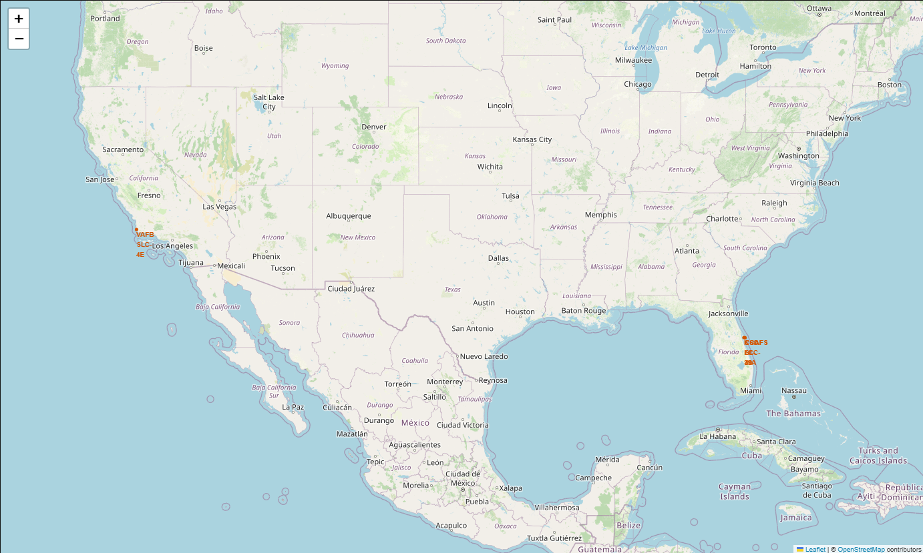
Launch Site Locations Overview
This graphic depicts all four launch sites used in the analysis
Three launch sites are co-located on the east coast of Florida at Cape Canaveral & Kennedy Space Center
Vandenberg SFB is on the west coast of Southern California
All four launch sites are on the southern portion of the continental United States, closer to the equator

Slide 38
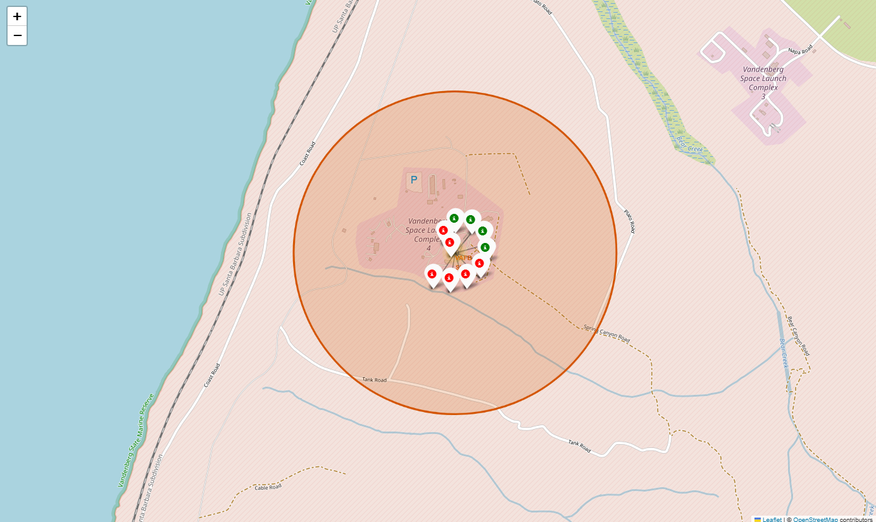
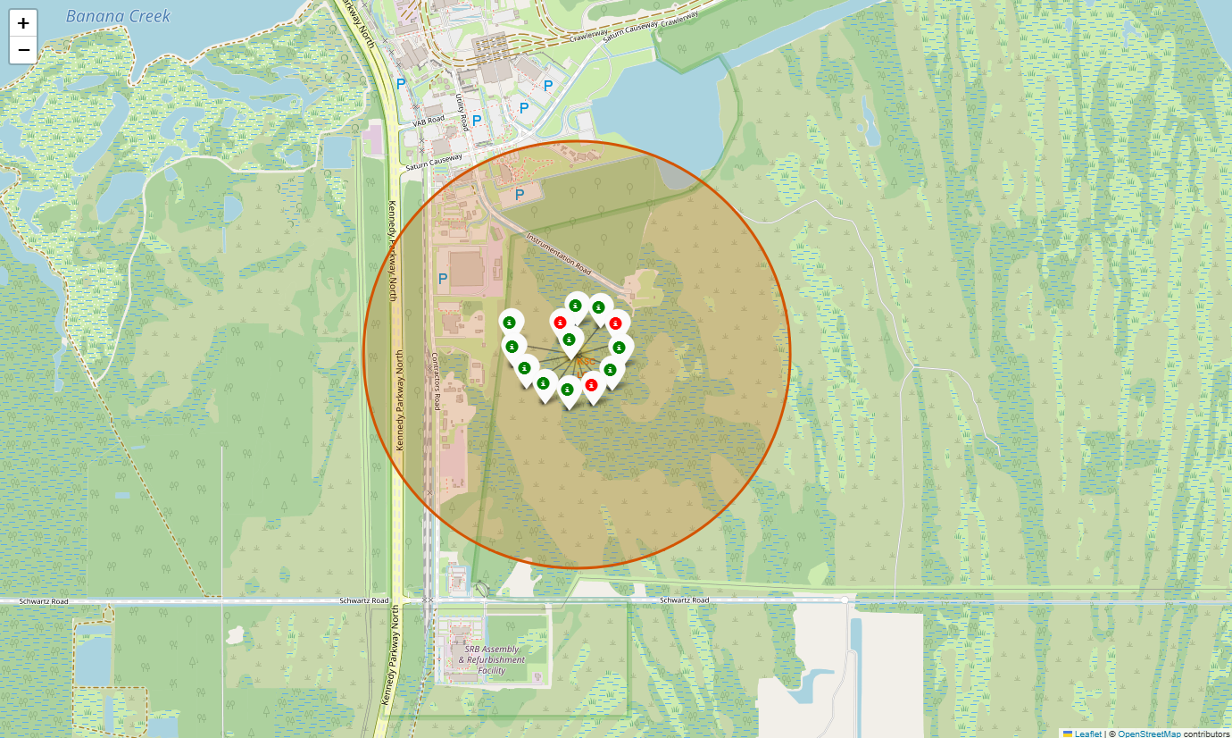
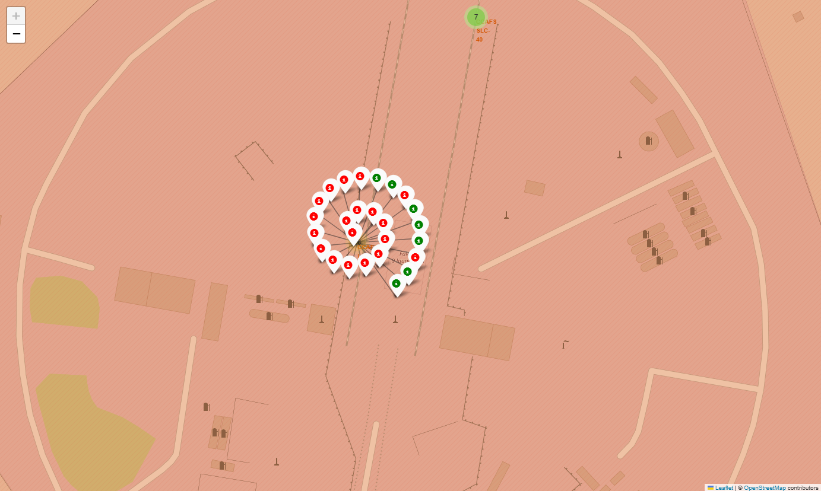
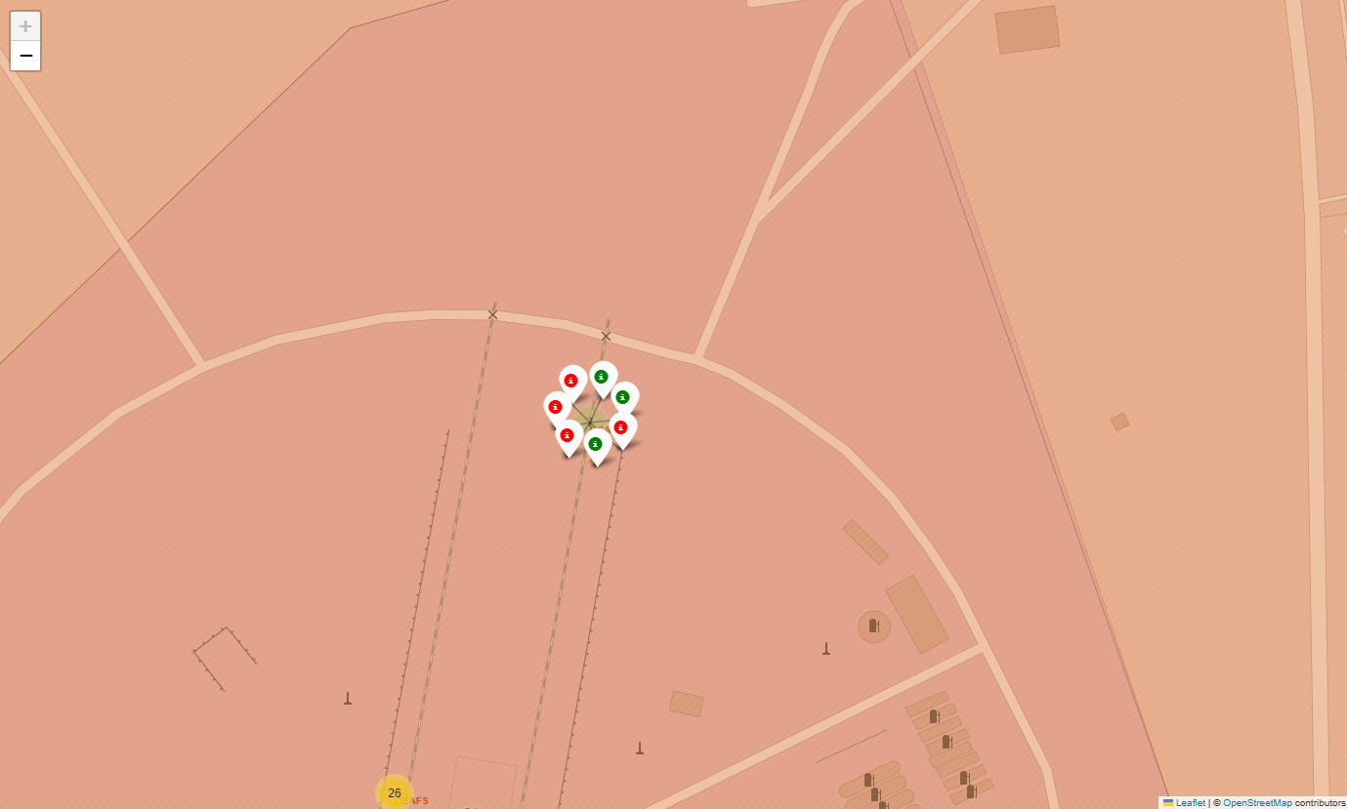
Launch Sites Close-Up
Vandenberg Space Force Base
Kennedy Space Center & Cape Canaveral
VAFB SLC-4E
KSC LC-39A
CCAFS LC-40
Close-ups of all four launch sites visually depicts landing outcomes
CCAFS LC-40: 7 successful; 19 failure
CCAFS SLC-40: 3 successful; 4 failure
KSC LC-39A: 10 successful; 3 failure
VAFB SLC-4E: 6 successful; 4 failure
It is observed that more launches occurred at the CCAFS LC-40 site and the least amount at the CCAFS SLC-40 site
The most percentage of success over failure is at the KSC LC-39A site
CCAFS SLC-40
Notes:
Replace <Folium map screenshot 2> title with an appropriate title
Explore the folium map and make a proper screenshot to show the color-labeled launch outcomes on the map
Explain the important elements and findings on the screenshot

Slide 39
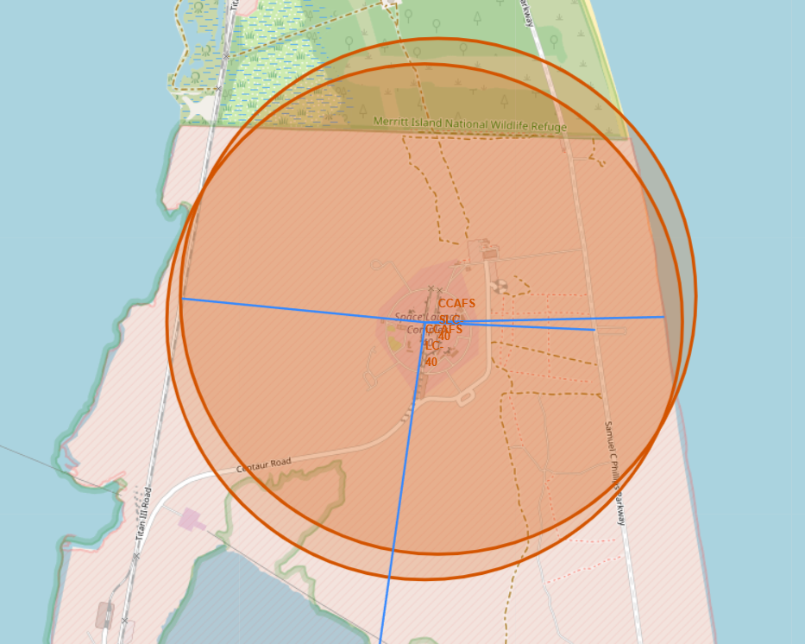
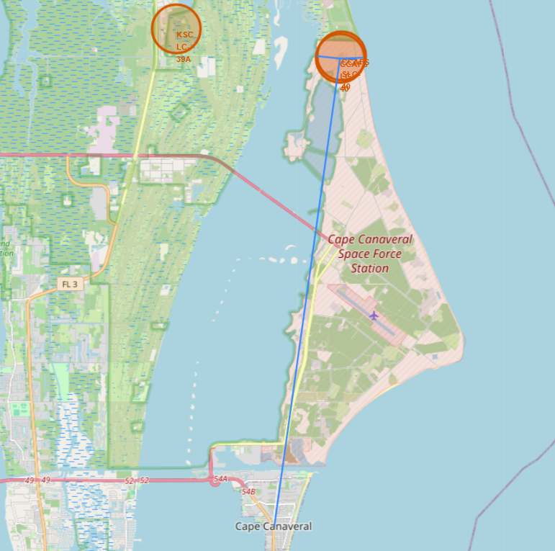
Distances from CCAFS LC-40
The CCAFS LC-40 Launch site has observed lines of communication (main road, railway) that are routed north to south on the eastern and western ends of the site. The limited access to the site most likely ensures security and safety for authorized personnel. Additionally, the closest city, Cape Canaveral, is approximately 20km south of the launch site. Due to safety concerns, launch sites are emplaced certain distances away from urban areas.
The observed launch site, along with the other three in this analysis are also situated on the coast. This is also most likely a safety measure to ensure minimal collateral damage from failed launches. It is also likely due to the technical mechanics of launching payload.
1
2
3
Distance from CCAFS LC-40
Railway – 0.94km
Coastline – 0.93km
Highway – 0.66km
City – 19.58km
4
Notes:
Replace <Folium map screenshot 3> title with an appropriate title
Explore the generated folium map and show the screenshot of a selected launch site to its proximities such as railway, highway, coastline, with distance calculated and displayed
Explain the important elements and findings on the screenshot

Slide 40

Section 4

Slide 41
Success Rate by Launch Site
KSC LC-39A has the highest success rate at 41.7%. Thirteen launches were recorded at this site and three launches failed.
Although the CCAFS LC-40 site has the second highest success rate, it 19 failed flight launches out of 26 recorded launches.
Notes:
Replace <Dashboard screenshot 1> title with an appropriate title
Show the screenshot of launch success count for all sites, in a piechart
Explain the important elements and findings on the screenshot

Slide 42
KSC LC-39A Launch Site Success Rate
The KSC LC-39A site also has the highest success outcome ratio of the four sites. Of the 13 launches from this sight, there was an approximately 77% success rate.
Notes:
Replace <Dashboard screenshot 2> title with an appropriate title
Show the screenshot of the piechart for the launch site with highest launch success ratio
Explain the important elements and findings on the screenshot

Slide 43
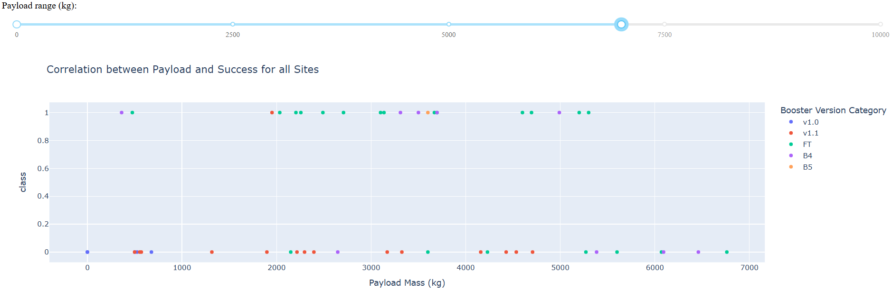
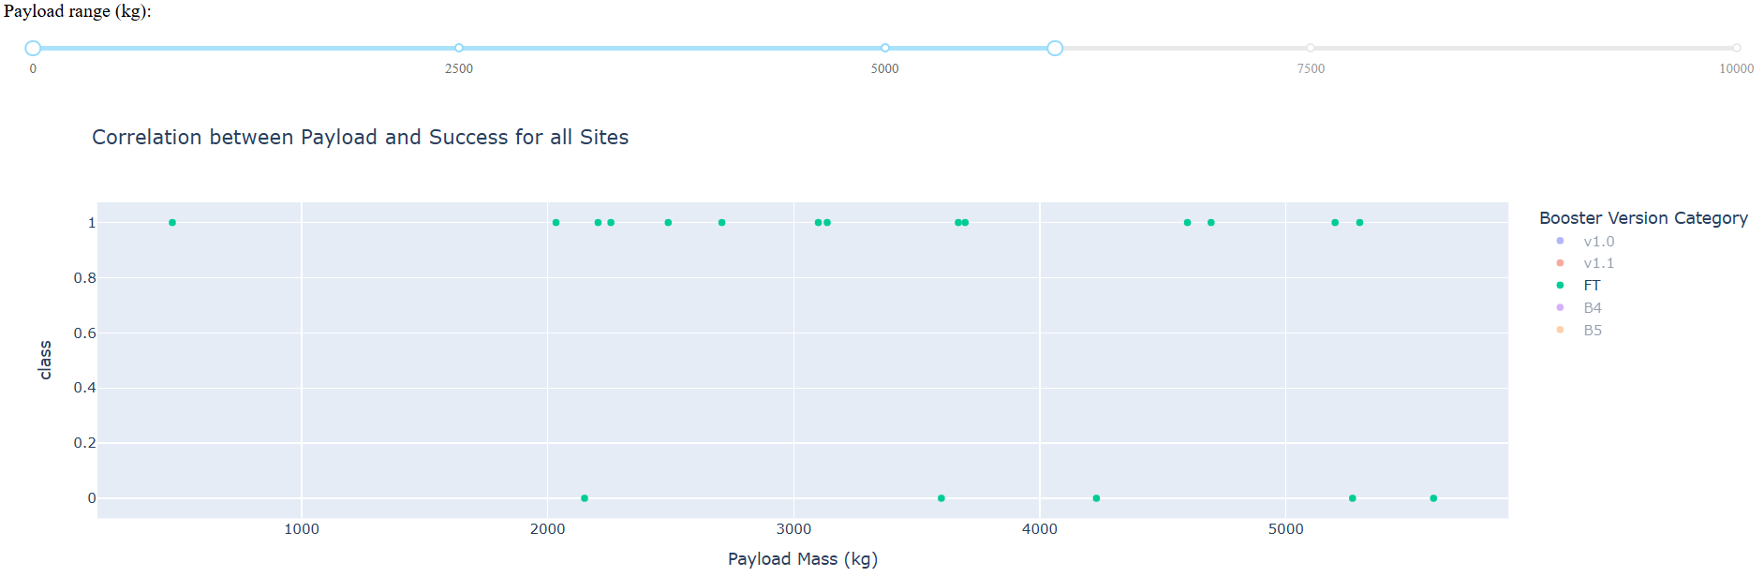
Payload Mass vs Success Rates for all Launch Sites
The top graph depicts the area of where most launches failed, which are payload masses between 500kg to 6761kg. The majority of the failed launches were from the Falcon 9 v1.1 (red).
The bottom graph shows that the Falcon 9 FT model had the most successful with payload masses between 475kg and 5300kg
Notes:
Replace <Dashboard screenshot 3> title with an appropriate title
Show screenshots of Payload vs. Launch Outcome scatter plot for all sites, with different payload selected in the range slider
Explain the important elements and findings on the screenshot, such as which payload range or booster version have the largest success rate, etc.

Slide 44

Section 5

Slide 45
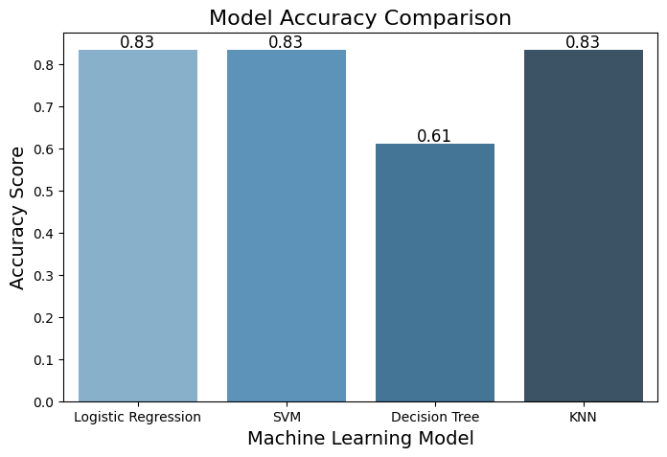
Classification Accuracy
When comparing the predictive model accuracy for four models, three of the four models performed with the same accuracy.
Notes:
Visualize the built model accuracy for all built classification models, in a bar chart
Find which model has the highest classification accuracy

Slide 46
Confusion Matrix
Three of the four predictive models visually depicted the same confusion matrix.

Slide 47
Conclusions
In summary, this analysis attempted to identify contributors for successful launch outcomes from the SpaceX Falcon 9 rocket first stage landing. Various methodologies, including data collection & wrangling, exploratory data visualization, and predictive model accuracies, shows the likelihood SpaceX will continue to produce successful first stage reuse & relaunches.
Data records from 2013 to 2020 shows an upward trend of successful launch outcomes. Of the four launch sites on record, KSC L-39A had the highest total success rate at 41.7%. There is also observed 100% successful launch rates for the following orbit types: ES-L1, SSO, HEO, & GEO.
It is recommended to collect and analyze more SpaceX data after 2020 to determine any trends based on technological advances.

Slide 48
Appendix
Include any relevant assets like Python code snippets, SQL queries, charts, Notebook outputs, or data sets that you may have created during this project

Slide 49


